Slide 1
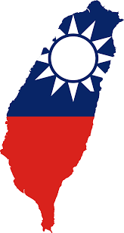
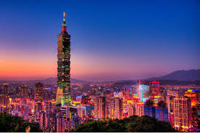
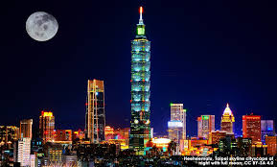
TAIPEI
IRENE TÉLLEZ CANO, VALERIE ULLLOA AVENDAÑO
3 eso d

Slide 2
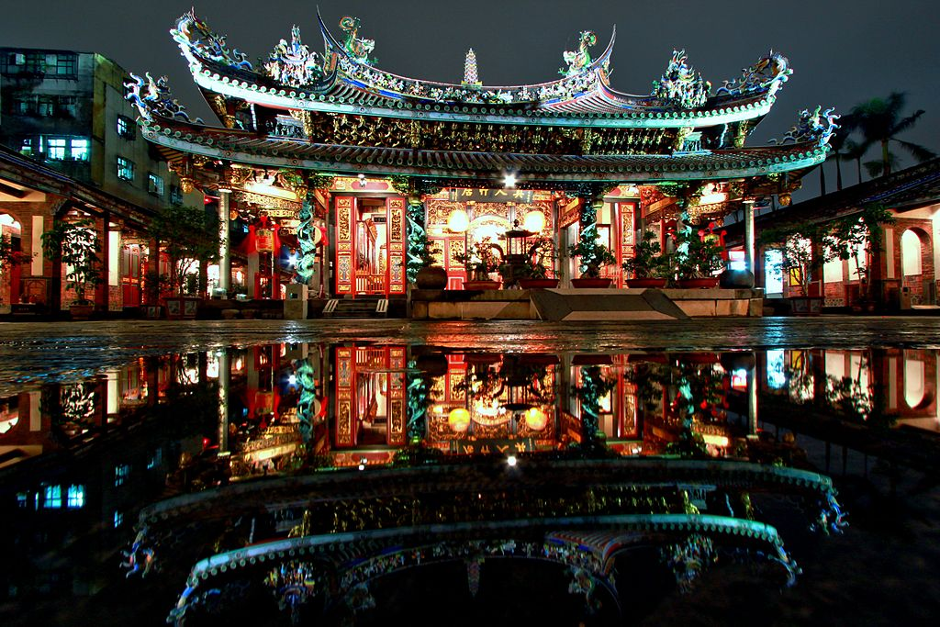
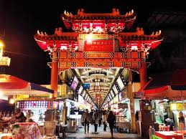
Index
Some basic facts
Where to go
What to do
Who´s from Taipei
typical FOOD and restaurantS
Festivals
CURIOUS THINGS
Activities
The end

Slide 3
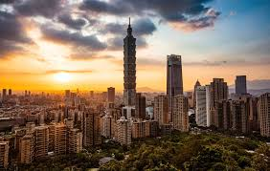
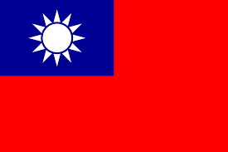
Some basic facts
Taipei is the capital of taiwan. IT Is a small city located in east Asia. Taipei has got an area of about 271 square kilometres and iTs population is about 2646 million PEOPLE. The elephant mountain is the best place to see the sunset in taipei.
Flag of Taiwan
Elephant Mountain

Slide 4
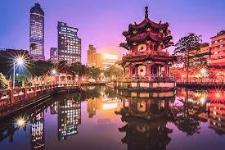
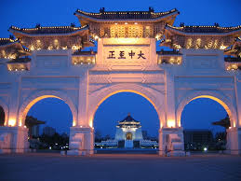
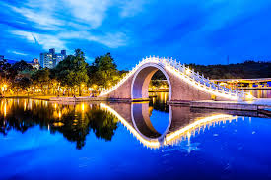
Where to go
THERE ARE MANY PLACES TO VISIT IN TAIPEI SUCH US NATIONAL MEMORIAL HALL, MOON bridge AND THE 228 PEACEs park ARE ALL VERY POPULAR WITH TOURIST.
228 peaces park
national memorial hall moon bridge

Slide 5
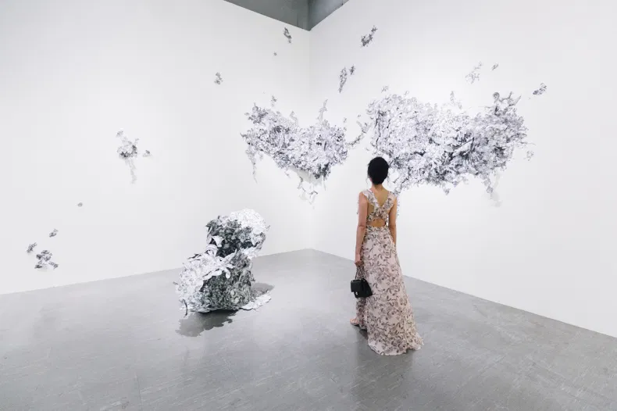
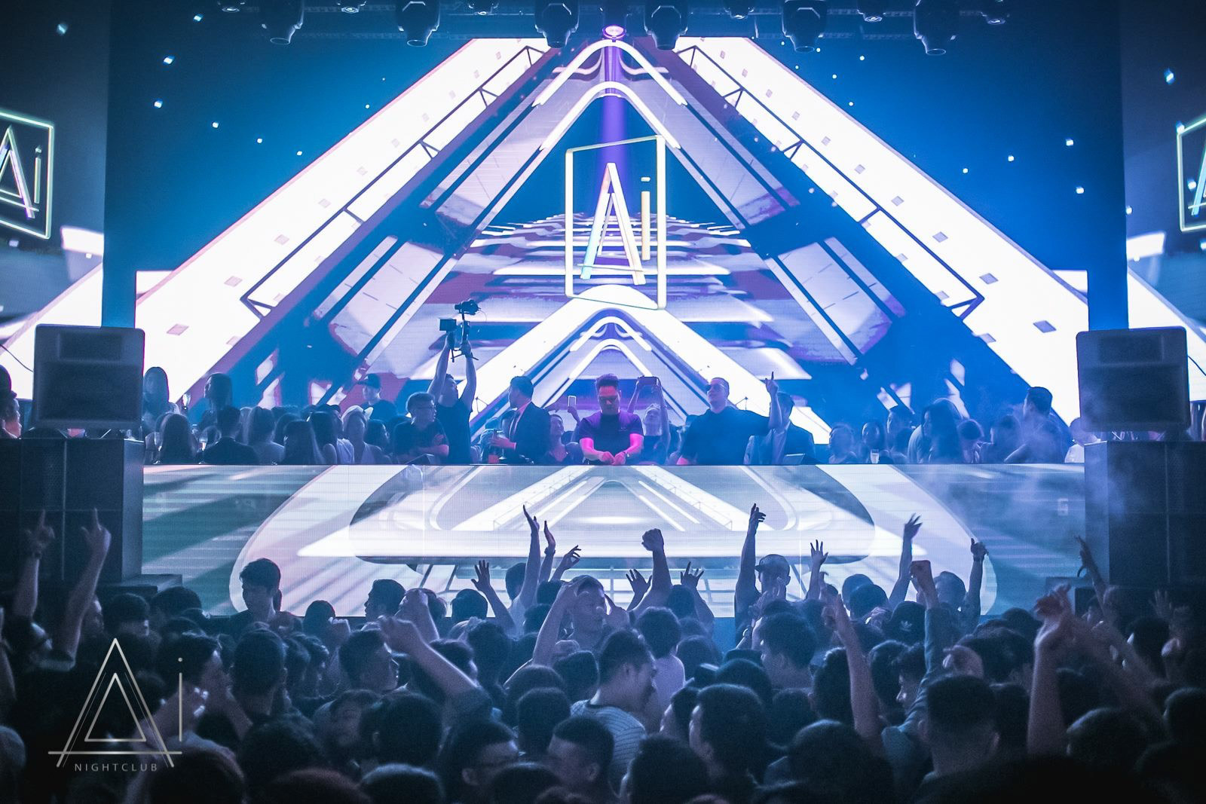
What to Do
YOU CAN DO MANY INTERESTING THINGS IN TAIPEI. IT HAS GOT MANY WONDERFUL MUSEUMS TO VISIT, SUCH US TAIPEI FINE ARTS MUSEUM. THERE ARE SOME GREAT NIGHTCLUBS TOO, AND MANY OF THEM ARE IN THE CITY´S NORTH AREA. yOU CAN ENJOY A WONDERFUL TIME WITH YOUR FRIENDS.
Fine Arts museum Nightclub

Slide 6
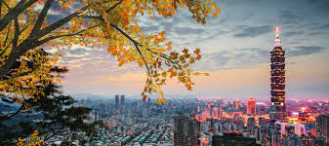
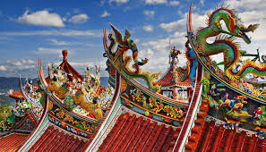
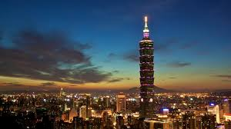
Who´s from taipei
Taipei is not recognized for beING famous but for its landscapes and also for its history.

Slide 7
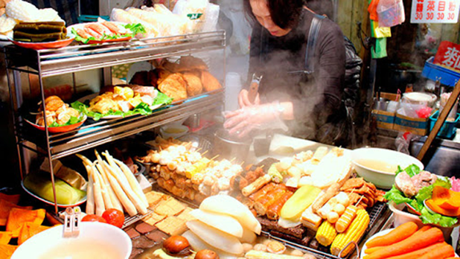
TYPICAL FOOD
You can fInd some delicious food in Taipei:
Noodle soup with cow,
Xiaolongbao,
Pork cooked in rice,
Oyster omelette…

Slide 8
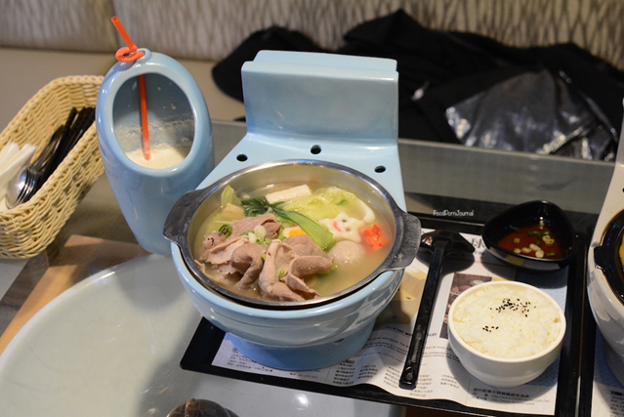
Restaurants
There is an interesting anD unusual restaurant in taipei: the modern toilet restaurant.
It is a restaurant with the TYpical food of Taiwan. But it has drums instead of plates.

Slide 9
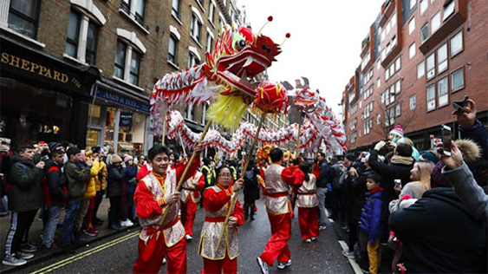
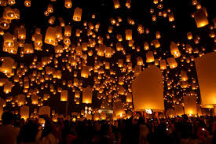
Festivals
There are some exciting festivals:
Spring party,
Folk arts festival,
´´Farolito´´ party,
The birth of Confucius,
The dragon boat.

Slide 10
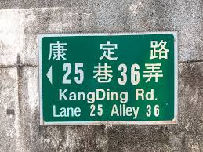
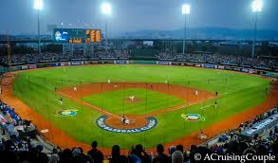
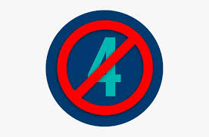
Curious things
It IS one of the countries that recycles the most in the world.
Due to susperstition , taiwan’s license plates and indetity cards never end with the number 4, since when pronounced it looks like the world death. Many buildings also do not have the number 4 floor.
Baseball is the most popular sport in Taipei.

Slide 11
activities
. Where is located Taipei?
Taiwan
. what is the most popular sport in Taipei?
the baseball
. WHAT IS THE NAME OF THE RESTAURANT?
the modern toilet restaurant

Slide 12

Thank you

