Slide 1
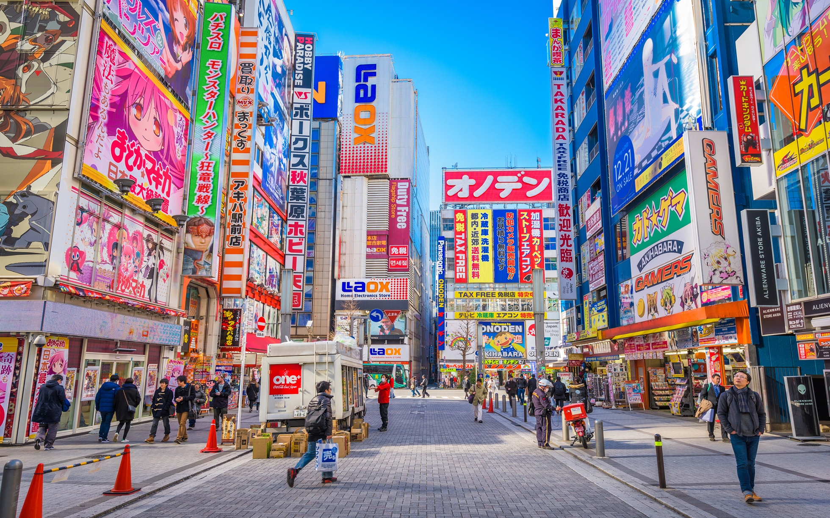

tokyo
Amaia de Larrauri &
Noelia Aranda Delgado.

Slide 2

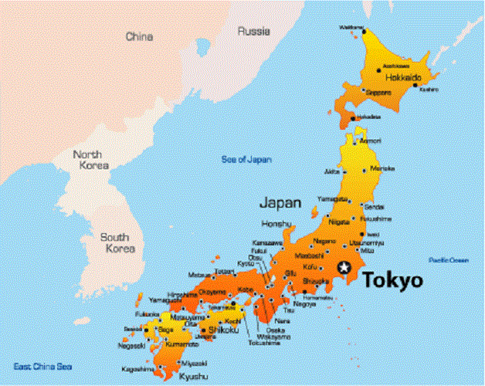
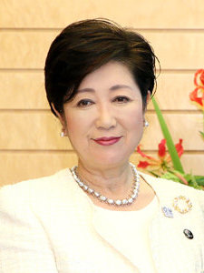
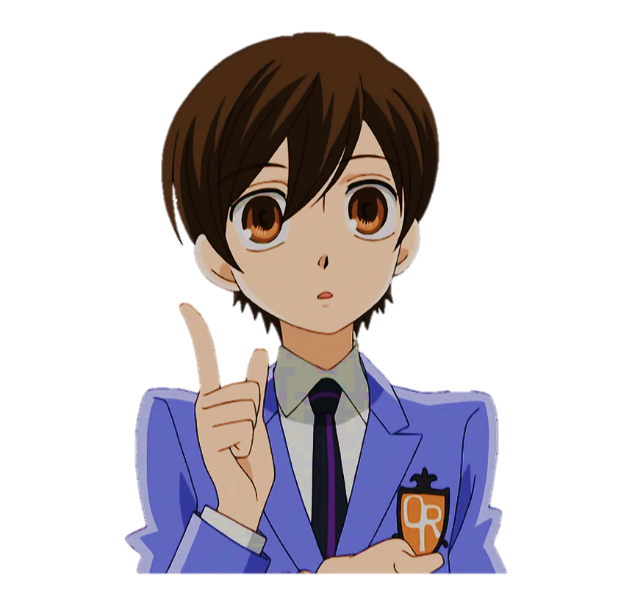
¬Some basic facts
Tokyo is the capital of Japan and it has approximately 13 million inhabitants. It is located on the Honshu island and its capital is Shinjuku.
Its governor is Yuriko Koike and it is the 45th largest city within 2187 km2 and water occupies 1% of that territory (21,87 km2).

Slide 3

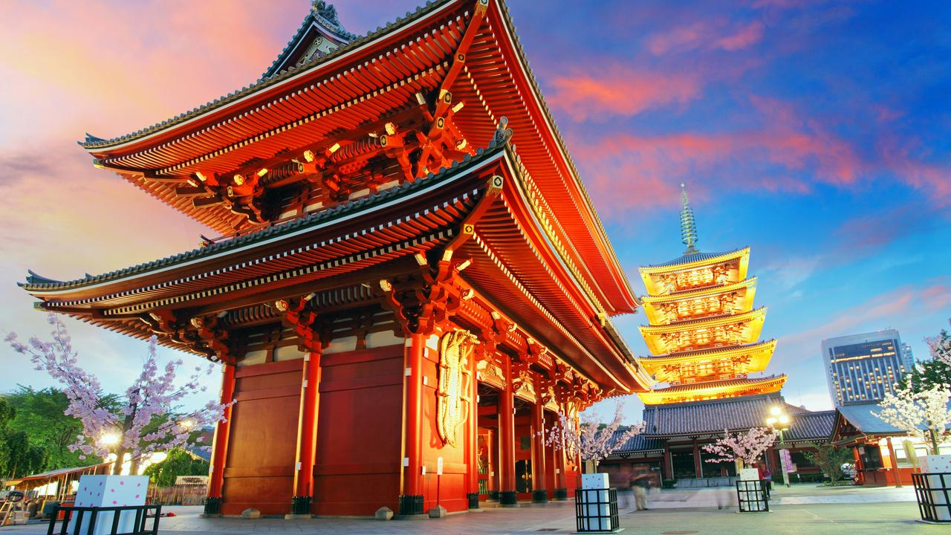
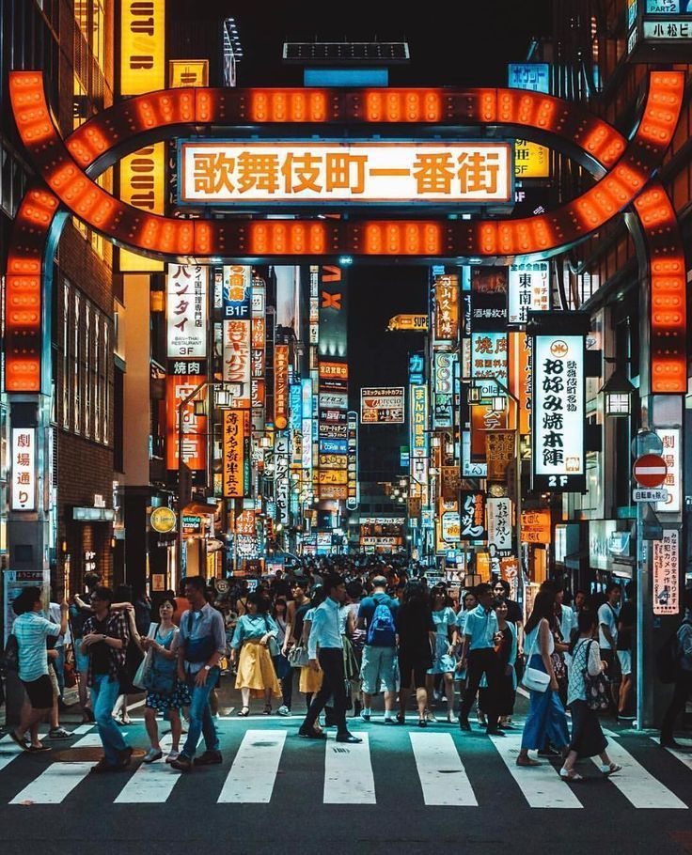
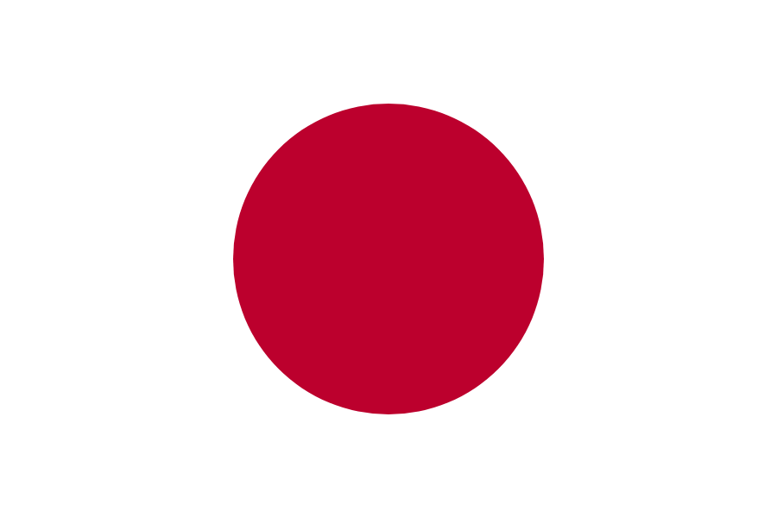
¬Some basic facts
The climate there is humid subtropical.
The language spoken is japanese because of their location.
Tokyo’s style is something between ultra modern and traditional. They have illuminated skyscrapers and old historical temples.

Slide 4
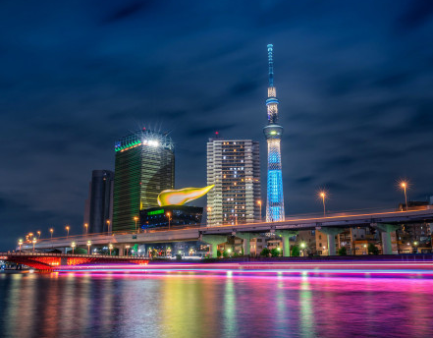
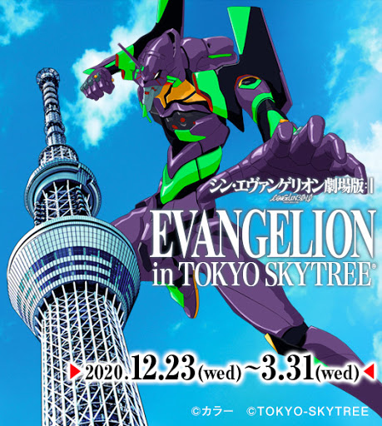
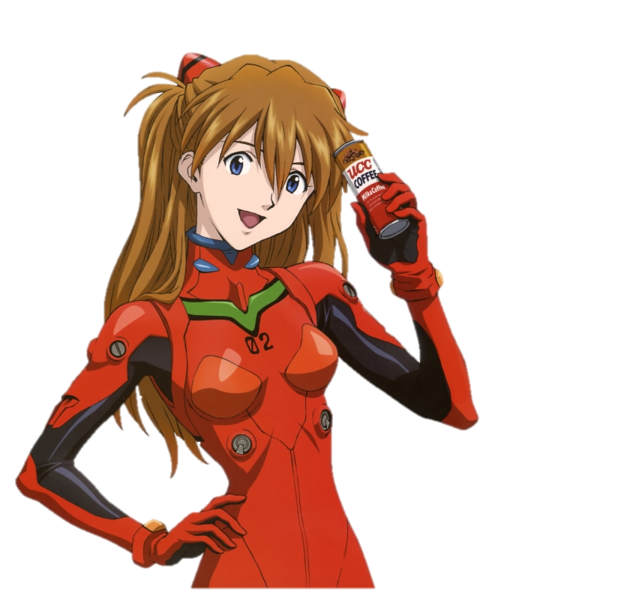
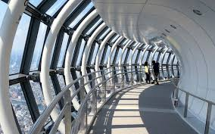
¬where to go
You can go visit a very famous skyscraper called Skytree, it measures 634 meters and it is also known as Tokyo’s New Tower, it has been Tokyo’s highest structure since 2010 and it has a lot of things inside, such as restaurants, a viewpoint…

Slide 5
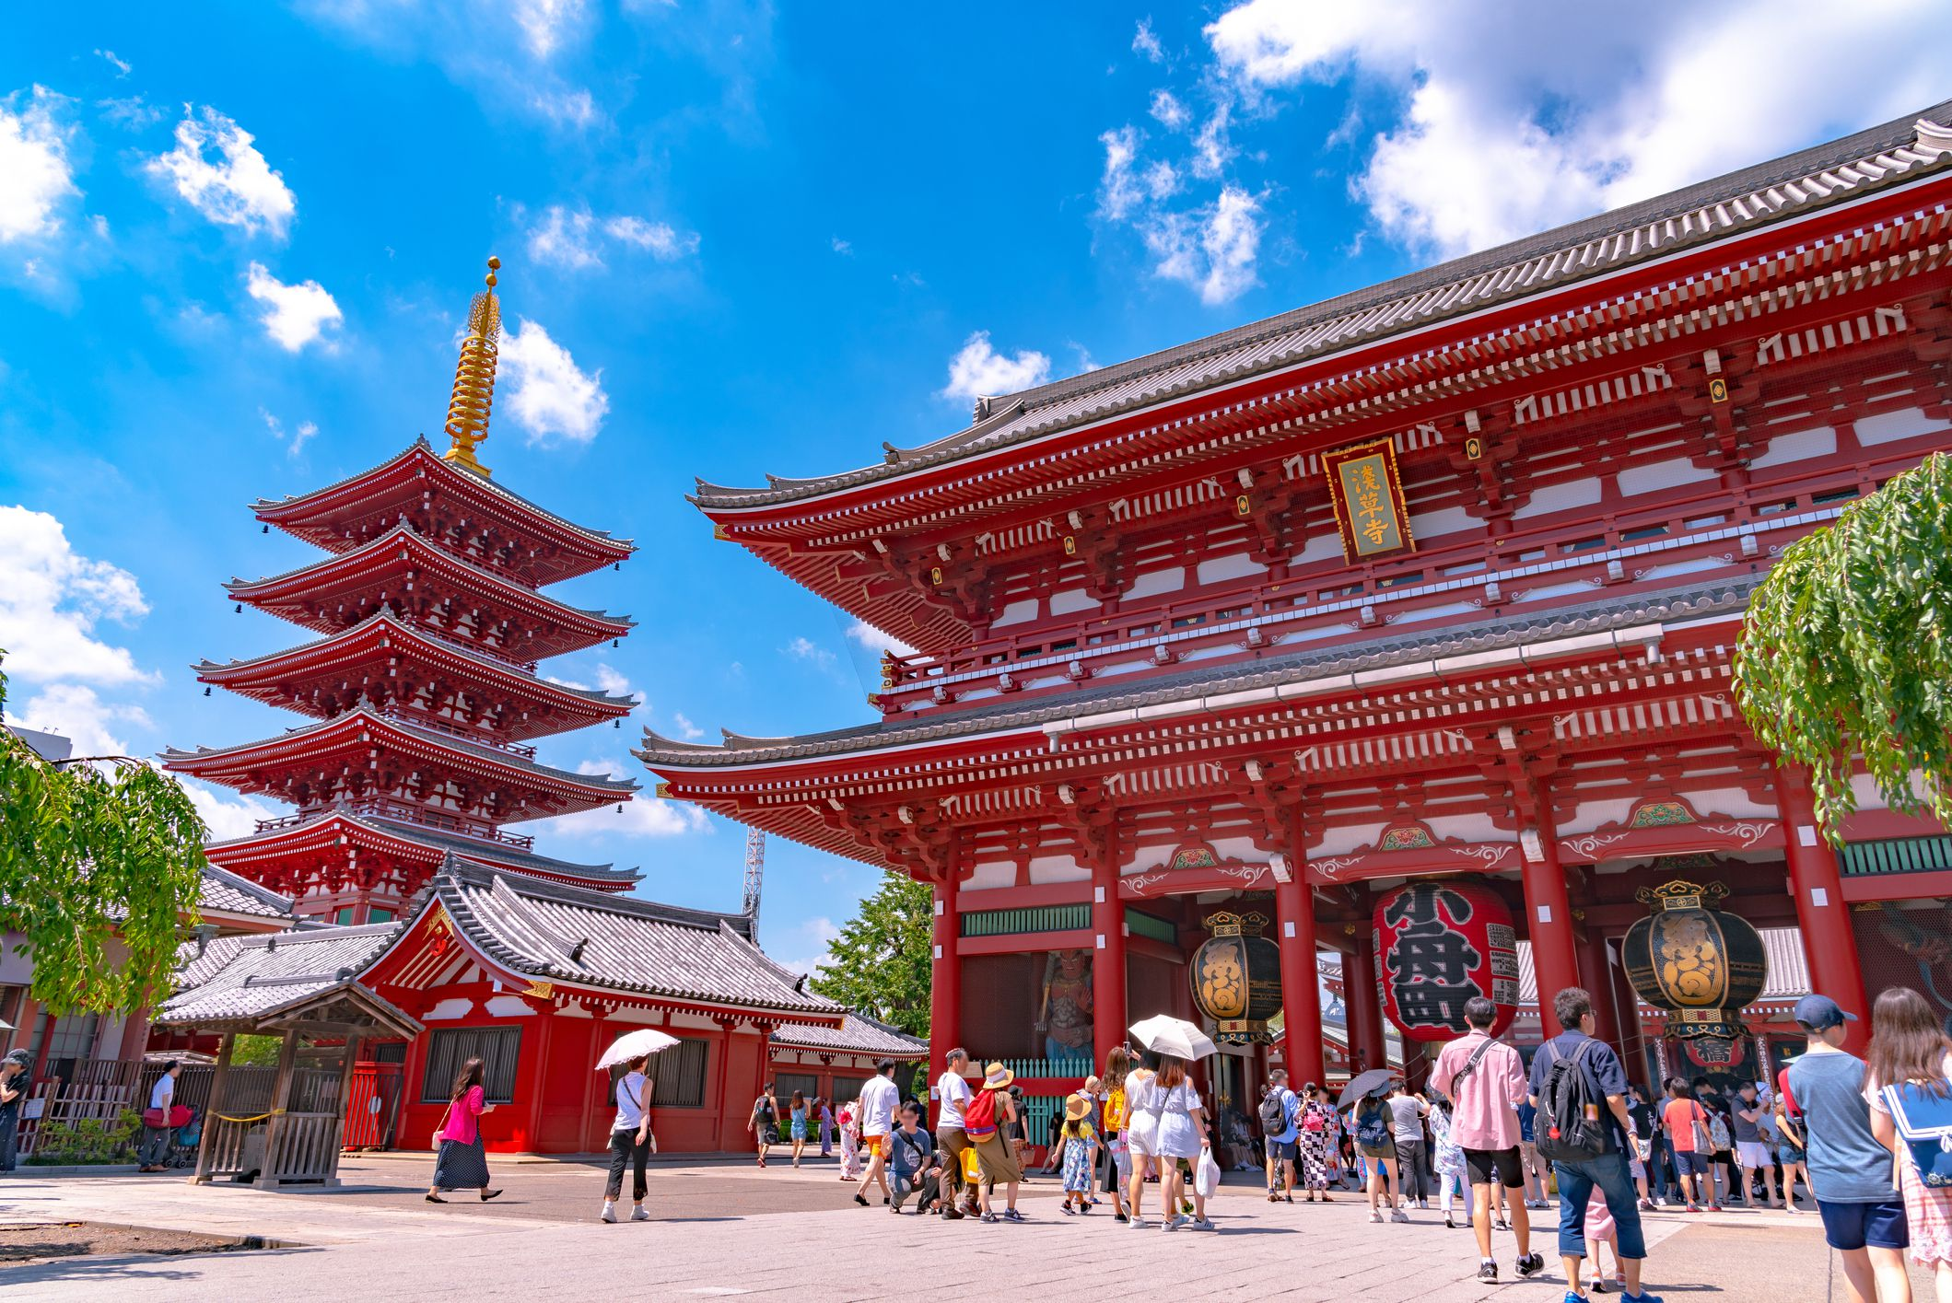
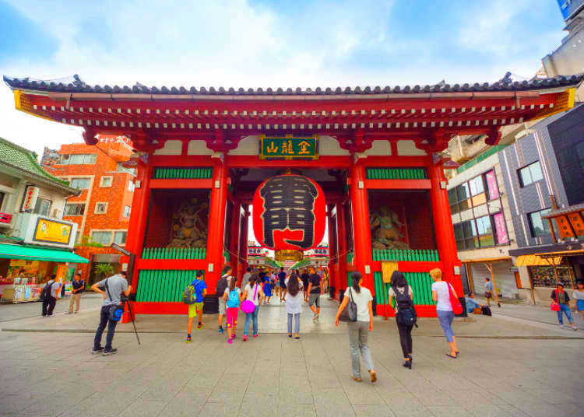

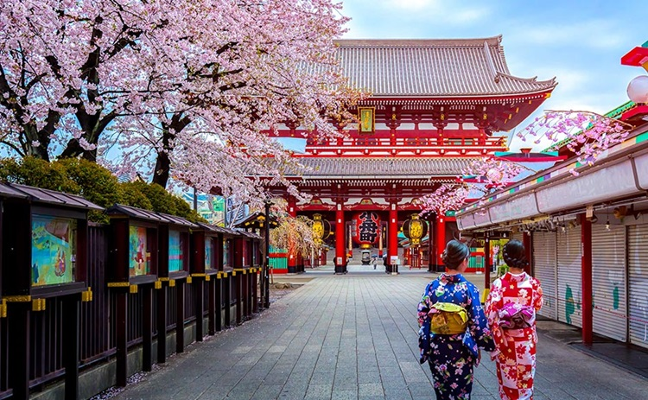
¬where to go
You can also visit Senso-Ji, it is a very well known Buddhist temple in Asakusa, Tokyo. It is the most important temple of Tokyo and also one of the most important ones.
And there are more places to visit there in Tokyo!

Slide 6
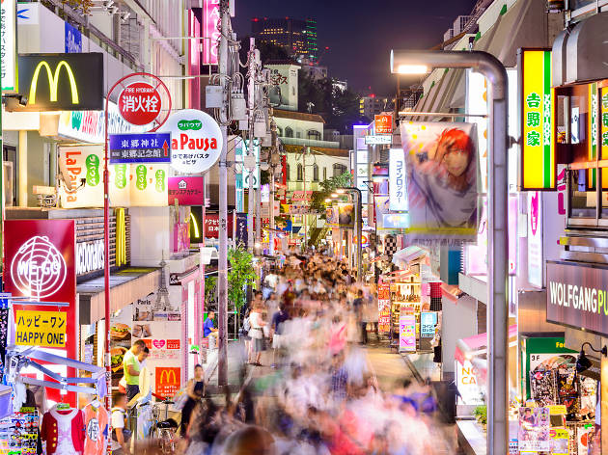
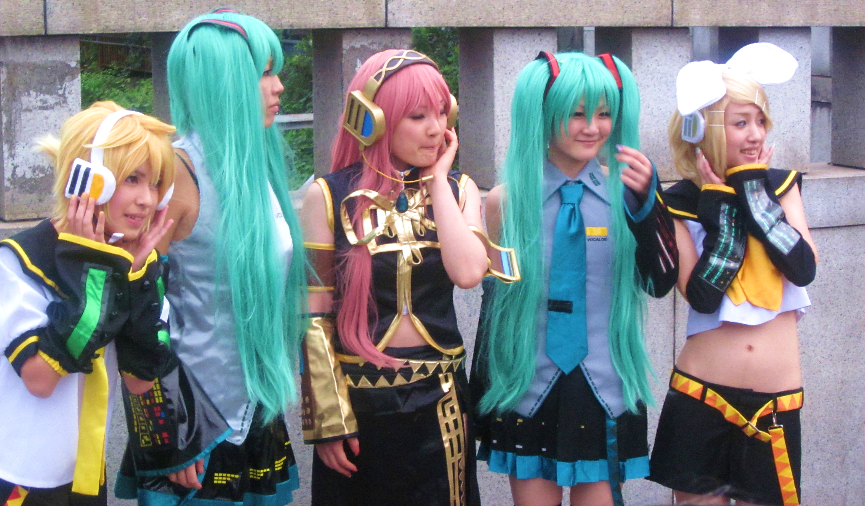
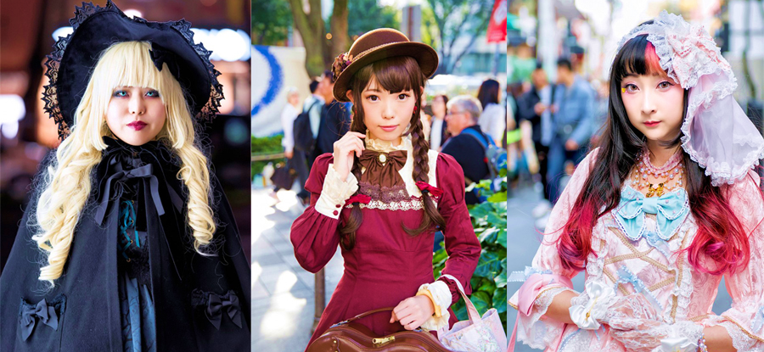

¬what to do
There are so many interesting things to do in Tokyo. For example, you can visit the neighbourhood, Harajuku, to buy some fashionable clothes and see various fashion styles in people there, such as Lolita, a Japanese fashion inspired by Victorian and Rococo clothing. There are actually people in there doing cosplay too.

Slide 7
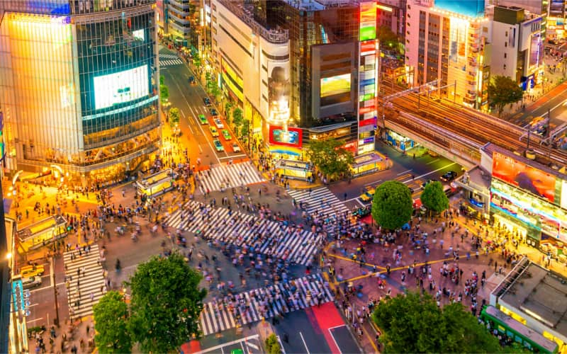
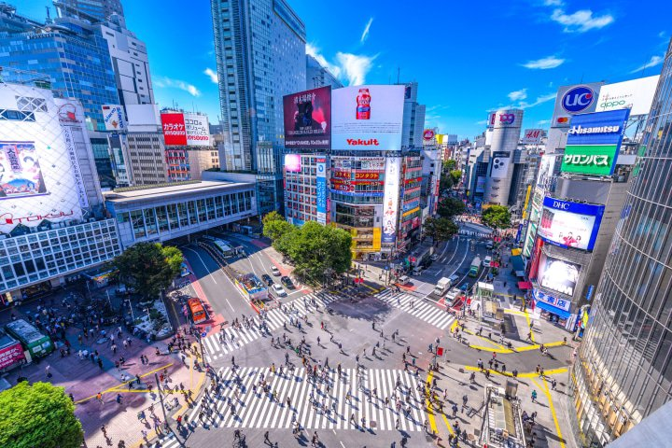

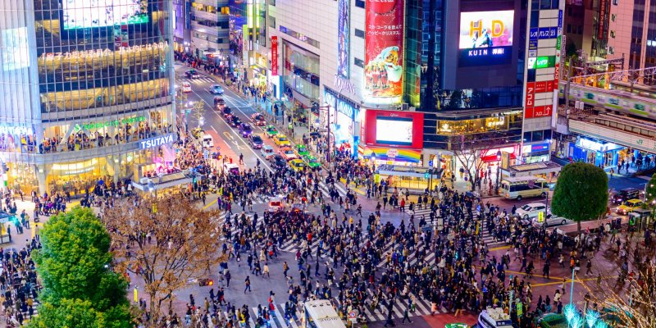
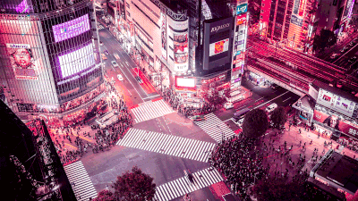
¬what to do
You can party all night in Shibuya. You can spend an entire evening sipping cocktails 30 floors up or rocking out at an underground DJ bar.

Slide 8
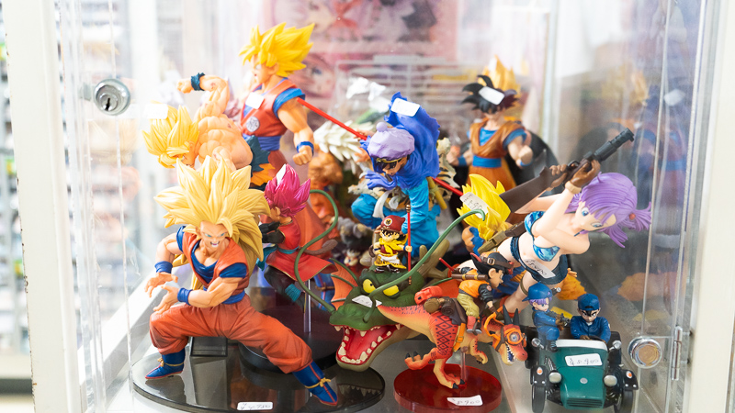
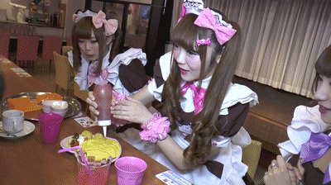

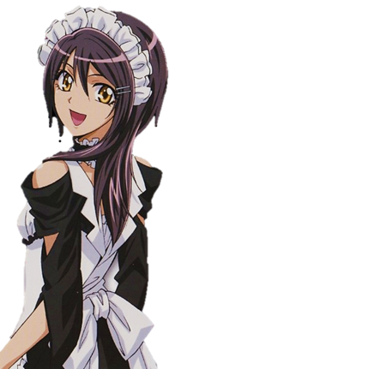
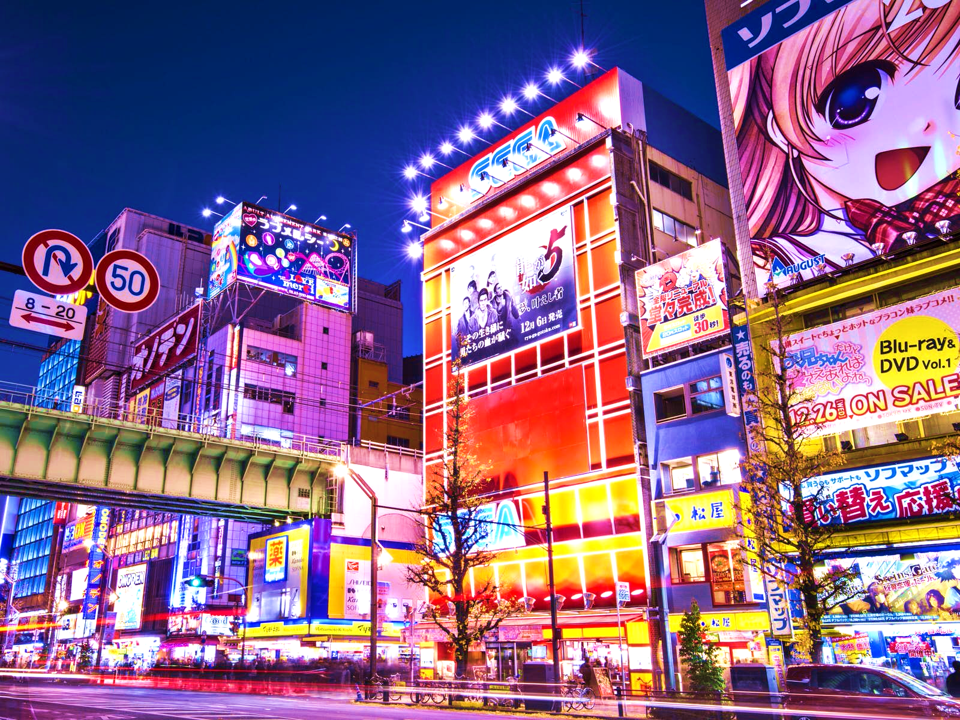
¬what to do
For anime lovers, I highly recommend going to Akihabara. There you can find everything you need from your favorite anime, game or manga. Also there you can visit a Maid cafe which is very famous in Japan.

Slide 9
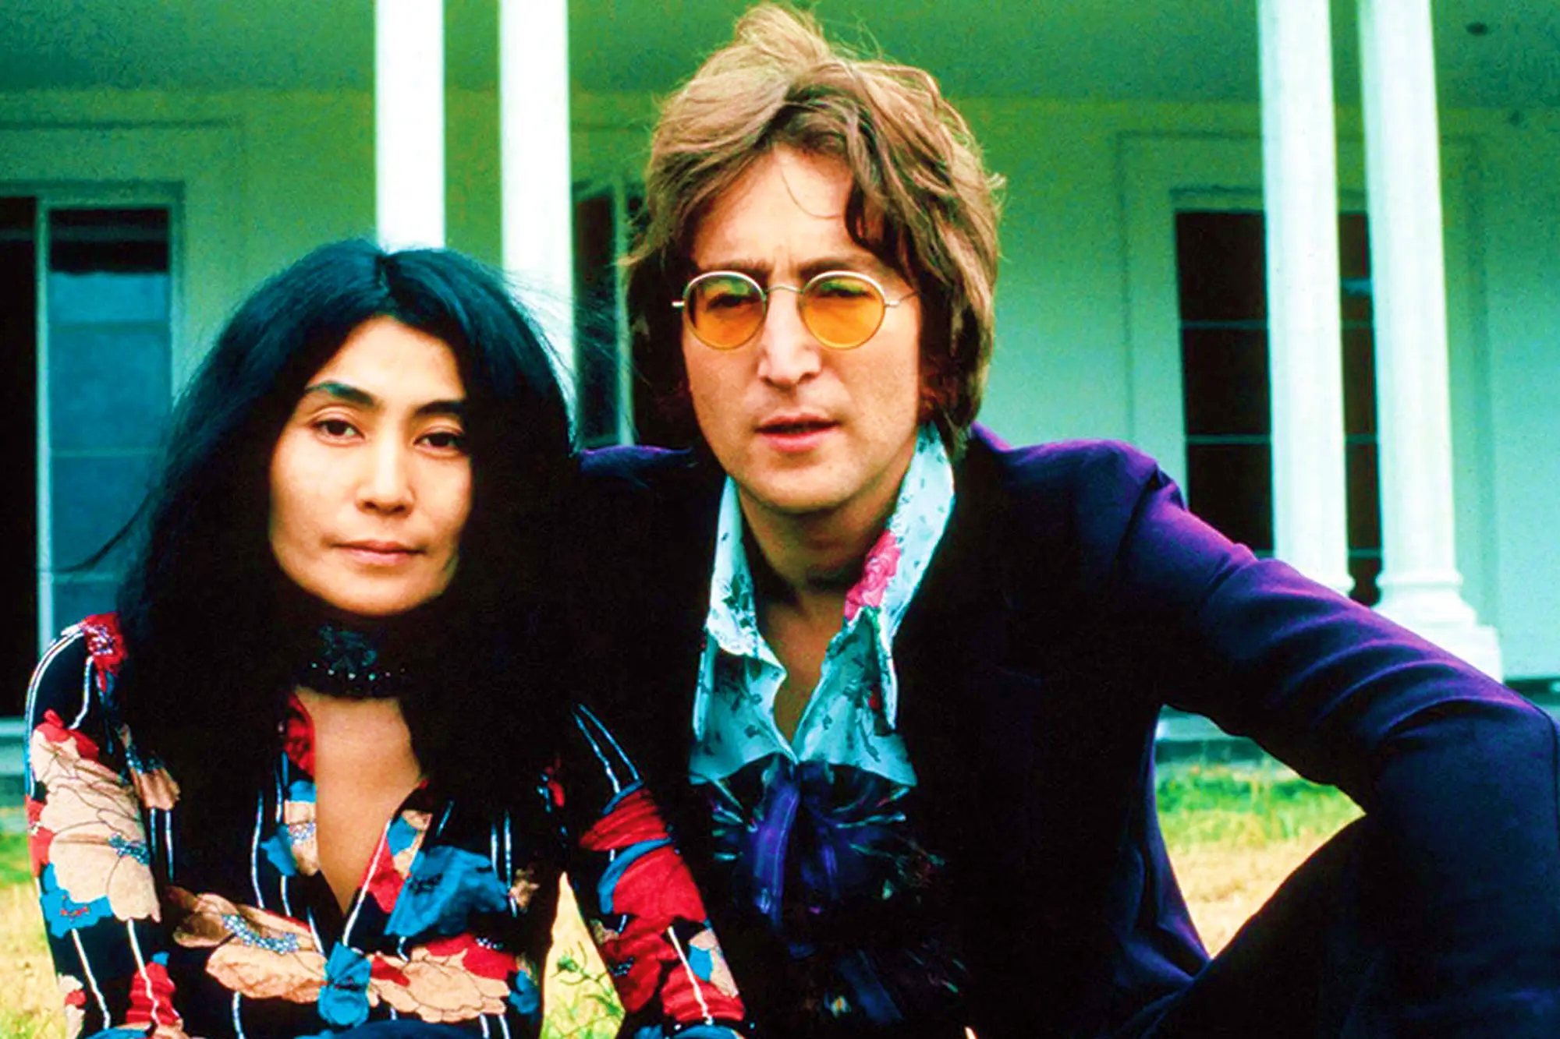
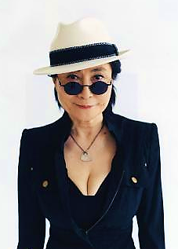
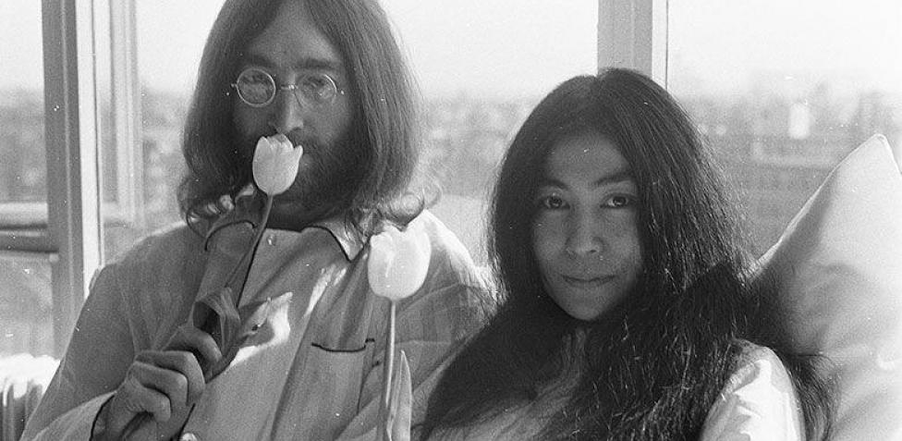
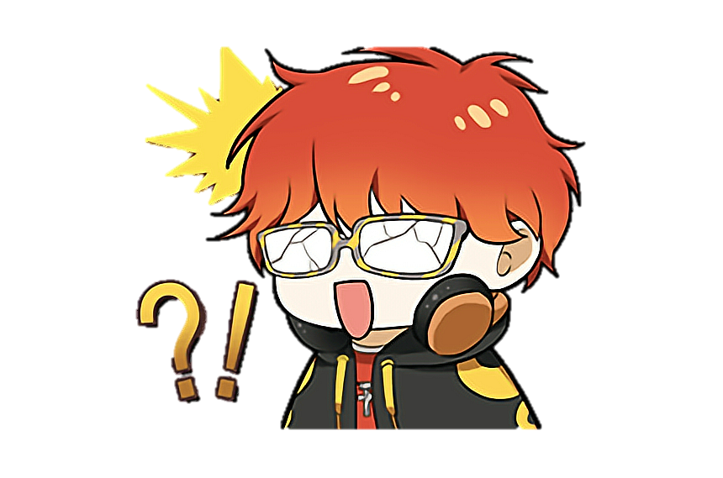
¬who’s from tokyo
One of the most famous people in Tokyo is Yoko Ono (小野陽子), who was married with John Lennon, a member of the famous music band, The Beatles.

Slide 10

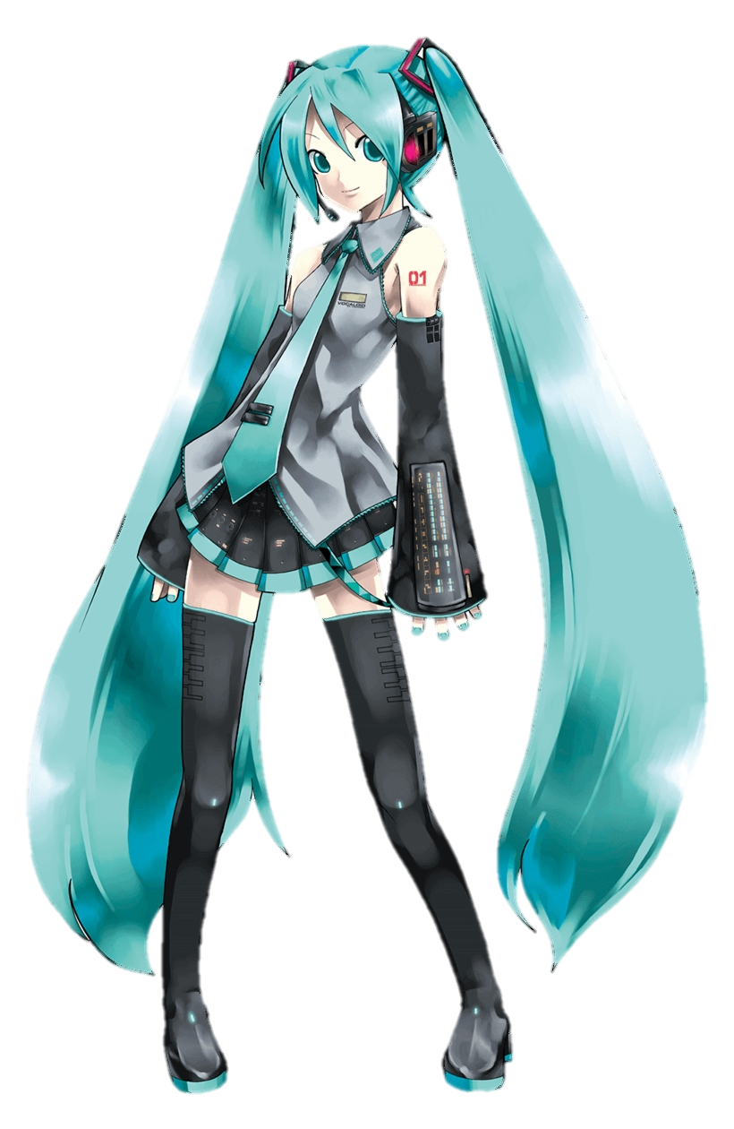
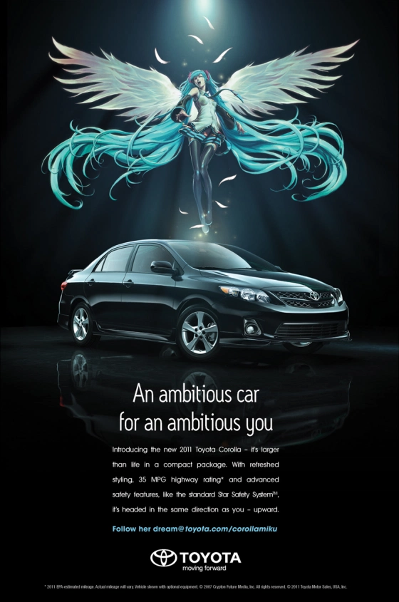
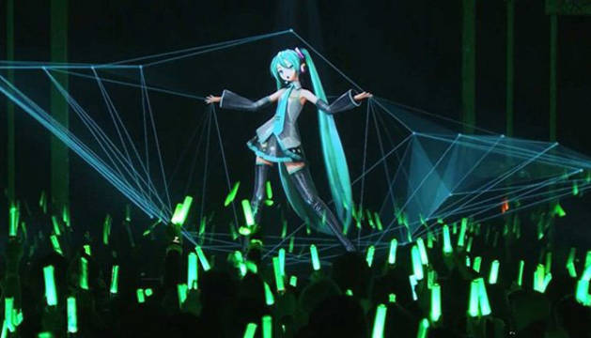
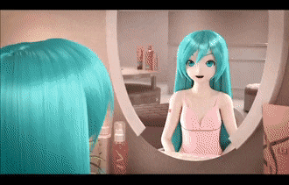
¬things from tokyo
The famous virtual singer, Hatsune Miku, was created by Crypton Future Media, being the best known VOCALOID to this day.
She has appeared in several commercials and in one she collaborated with Scarlett Johansson. His image was also used to sponsor a TOYOTA brand car.

Slide 11

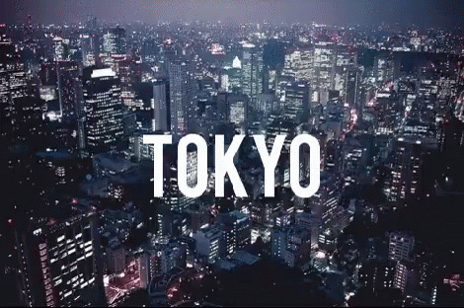
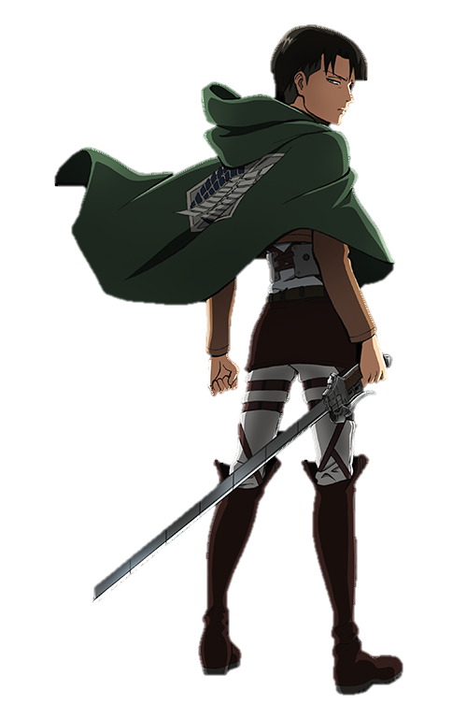
end
Thank you for your attention and we hope you liked it!

Slide 12
See you soon!
Amaia de Larrauri &
Noelia Aranda Delgado.

