Slide 1
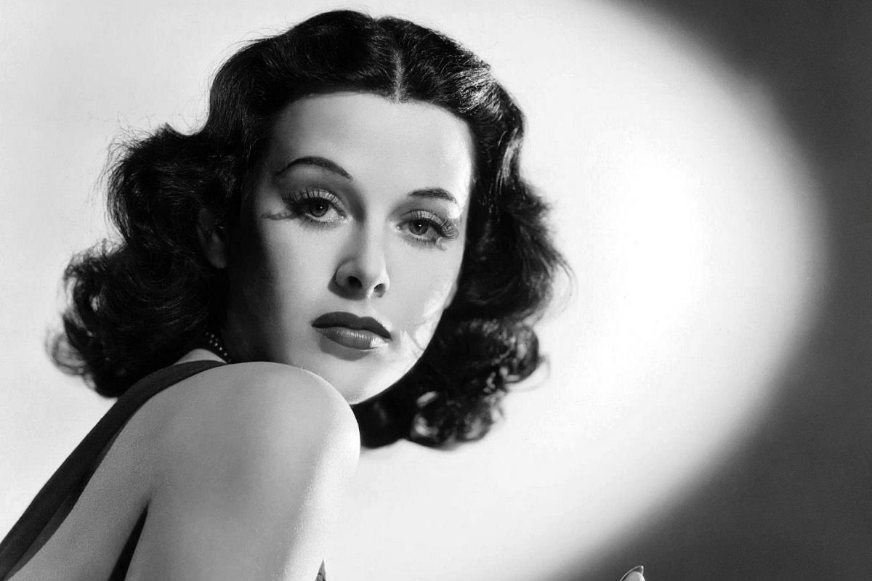


Slide 2
Hedy Lamarr
“Any girl can be glamorous. All you have to do is stand still and look stupid.”
“A good painting to me has always been like a friend. It keeps me company, comforts and inspires.”
“Hope & curiosity about the future seemed better than guarantees.”

Slide 3
INDEX
Title page………………………………………………………………………………….1,2
Index…………………………………………………………………………………………...3
Biography………………………………………………………………………………….4,5
Invention………………………………………………………………………………....6,7
Sources……………………………………………………………………………………….8
Kahoot………………………………………………………………………………………..9
Close…………………………………………………………………………………………10

Slide 4
BIOGRAPHY
* 9th November 1914 in Vienna as Hedwig Eva Maria Kiesler
Career as actor
First nude scene ever → movie was forbidden
Married Fritz Mandl in 1932
Fled to London → “Hedy Lamarr”
Hollywood star and most beautiful woman

Slide 5
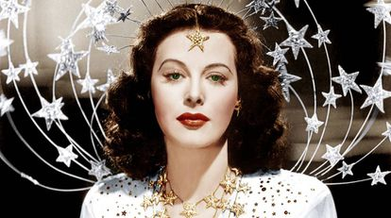

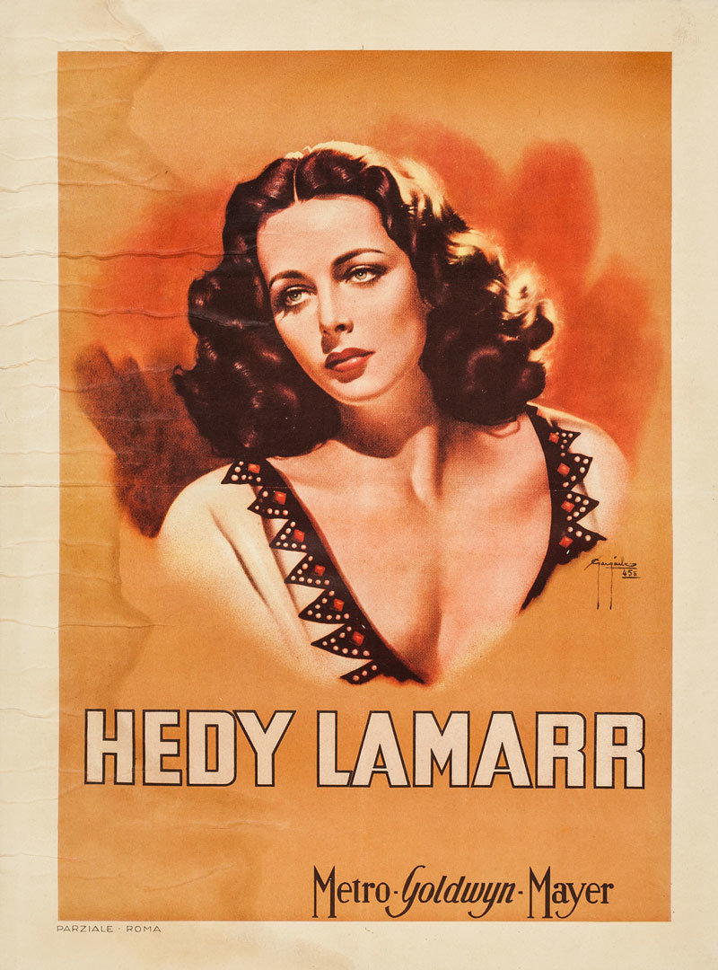
BIOGRAPHY
“System of communication” for
the allies
American sitizenship in 1953
Married six times and has 3 children
Disappearence from publics eye
in 1970s
19th January 2000 in Florida

Slide 6
INVENTION
1941→ “System of secret communication”.
Based on the 88 keys of a piano.
Able to avoid eavesdropping from the enemy.
Able to intercept communications and torpedo control.
It transforms ones and zeros into radio waves.

Slide 7
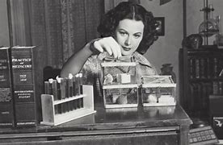
INVENTION
She offered her services to the U.S. Army.
First version of the spread spectrum.
Would enable long-distance
wireless communications.
Day of the Inventor is on 9 of
november in she's honor.

Slide 8
Sources
https://historia.nationalgeographic.com.es/a/hedy-lamarr-actriz-que-invento-wifi_14882
https://austria-forum.org/af/Biographien/Lamarr%2C_Hedy

Slide 9

KAHOOT
https://create.kahoot.it/details/fb688ce8-376e-4e06-aea7-4ef1e1560628
LET'S DO THE QUIZ!

Slide 10

Close
Thanks for listening!
Irene Téllez Cano y Emilia Majer Corona

